Slide 1


Mexico Toy Sales Data Analysis
Submitted by-
Aaqifa Taskeen
Arfa Khanum
Mumtaz Parveen
Sarvath Yasmeen

Slide 2
Required Analysis
Which product categories drive the biggest profits? Is this the same across store locations?
Can you find any seasonal trends or patterns in the sales data?
Are we losing any sales with products being out of stock at certain locations?
How much money is tied up in inventory at the toy stores? How long will it last?

Slide 3
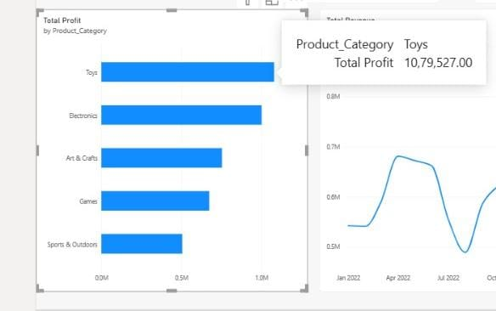
Q1. Which product categories drive the biggest profits? Is this the same across store locations?
PART-1:
Toys generated the highest total profit: $1,079,527 (26.89% of total profit).
Electronics followed closely at $1,001,437 (24.95%).
Toys + Electronics together contributed more than half of total profit.
How solved: Profit = Units Sold × (Product Price − Product Cost), summed by category.

Slide 4
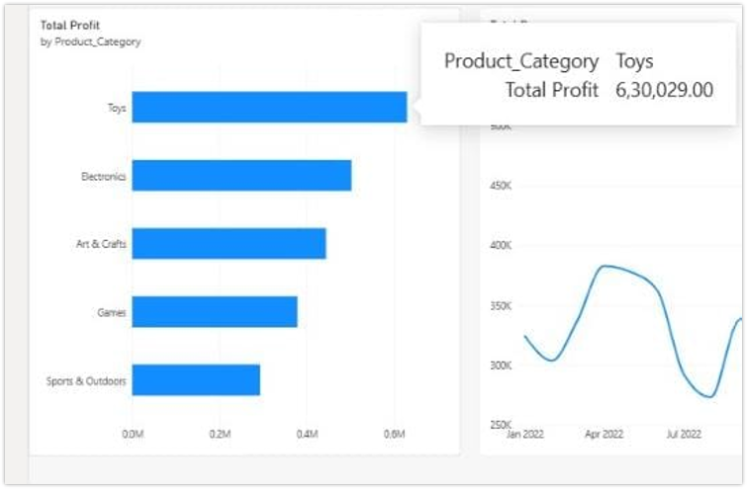
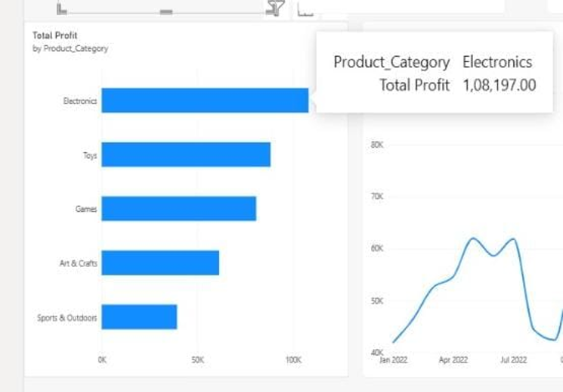
Q1. PART-2
No, the top-selling category is not the same across all locations.
At the Airport and Commercial locations, Electronic products had the highest sales.
In contrast, at the Downtown and Residential locations, Toys had the highest sales.
How solved: add Store Location as the comparison dimension and calculate Total Profit for every category-location combination

Slide 5
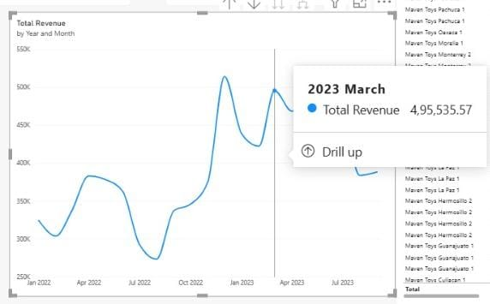
Q2. Can you find any seasonal trends or patterns in the sales data?
2022: revenue dipped to about $489K in August, then climbed sharply into December.
December 2022 was the highest month in the period shown, consistent with holiday demand.
2023: March reached about $884K; revenue then softened toward September.
2023 Oct–Dec are zero because the dataset ends in September 2023—not because demand disappeared

Slide 6
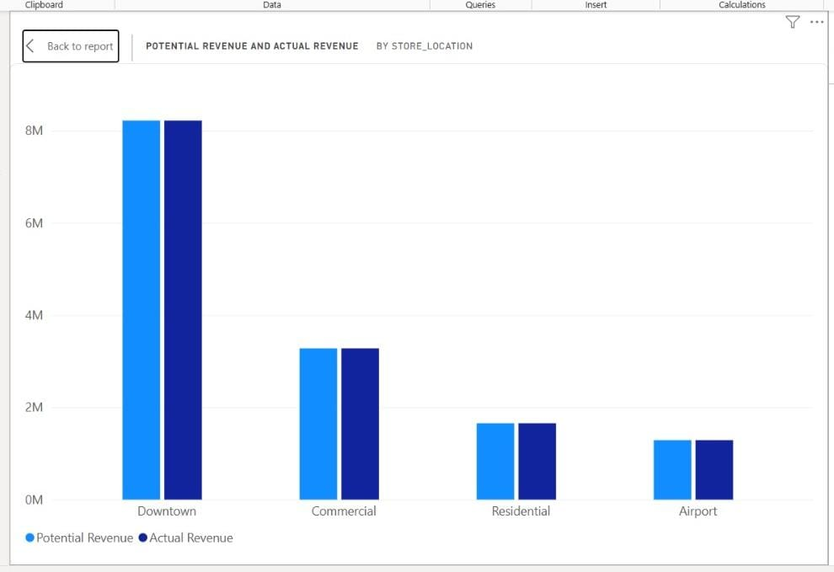
Q3. Are we losing any sales with products being out of stock at certain locations?
Yes. Every store-location type shows a gap between potential and actual revenue
How solved: compare revenue associated with available stock (>0) against revenue associated with unavailable/zero stock; lost revenue = potential − actual.

Slide 7
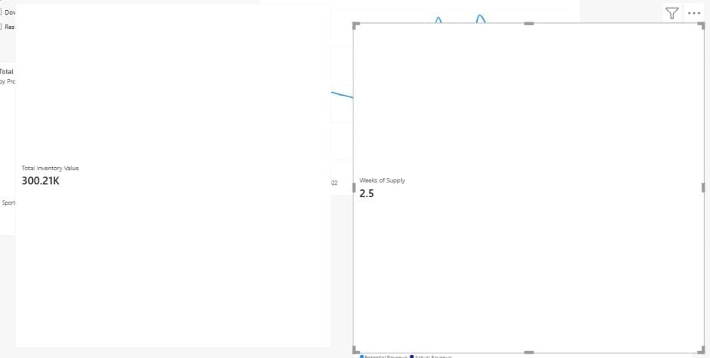
Q4. How much money is tied up in inventory at the toy stores? How long will it last?
Inventory is valued at product cost, then compared with average daily unit sales.
$300,210K is tied up in the inventory.
It will last for approximately 2.5 weeks.
Inventory value = Σ(Stock on Hand × Product Cost).
Coverage = Total Stock on Hand ÷ Average Units Sold per Day.

Slide 8
Thank You

